Slide 1

PROJECT ON
JARVIS DESKTOP VOICE ASSISTANT
Presented By : Maruri Nitish Kumar Rao
Class : BCA 5th SEM
Roll No. : 608621861011

Slide 2
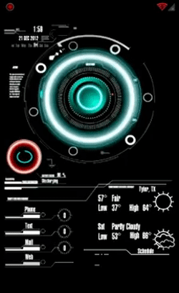
CONTENTS
Introduction
Tools & Technologies
Hardware Requirements
Software Requirements
Modules/Libraries Used
Implementation
Tasks
Advantages/Disadvantages
References

Slide 3
INTRODUCTION
JARVIS – Desktop voice assistant is a voice-recognition artificial intelliger application designed by me to perform tasks or services for an Individual based on commands or questions.
It can play music from computer or from YouTube.
It can do Wikipedia searches for you.
It is capable of opening websites like Google, YouTube, etc in a web browser.
It is capable of opening apps like code editor, command prompt, notepad, chrome etc.

Slide 4


TOOLS & TECHNOLOGIES
Version : 3.11
Version : 1.83

Slide 5
Hardware Requirements
PC or Laptop.
For PC microphone is required as laptop has inbuilt microphone.
Internet connection.
At least 1 GB Ram.
512 MB Graphic card

Slide 6
Software Requirements
Windows XP or Higher versions.
Visual Studio Code.
Python Script.
PYQT5 Designer.

Slide 7
Moules/Libraries Used:
Pyttsx3
A python library that will help us to convert text to speech. In short, it is a text-to-speech library.
It works offline, and it is compatible with Python 2 as well as Python 3.
Datetime
To provide current or live time to Assistant.
Used for greeting user according to time.
Speech Recognition
Library for performing speech recognition, with support for several engines and APIs, online and offline.
Used for taking input from microphone as a source to perform tasks.
Wikipedia
Wikipedia is a Python library that makes it easy to access and parse data from Wikipedia.
It helps the user to get results for a particular query or search.

Slide 8
Web Browser
The web browser module provides a high-level interface to allow displaying Web-based documents to users
Under most circumstances, simply calling the open() function from this module will do the right thing.
OS
The OS module in Python provides functions for interacting with the operating system.
This module provides a portable way of using operating system-dependent functionality.
Random
We can generate random numbers in Python by using random module.
These are pseudo-random number as the sequence of number generated depends on the seed.
PyAutoGui
Pyautogui is a library that allows you to control the mouse and keyboard to do various things.
In this project we use this library for taking screenshots of the screen.

Slide 9
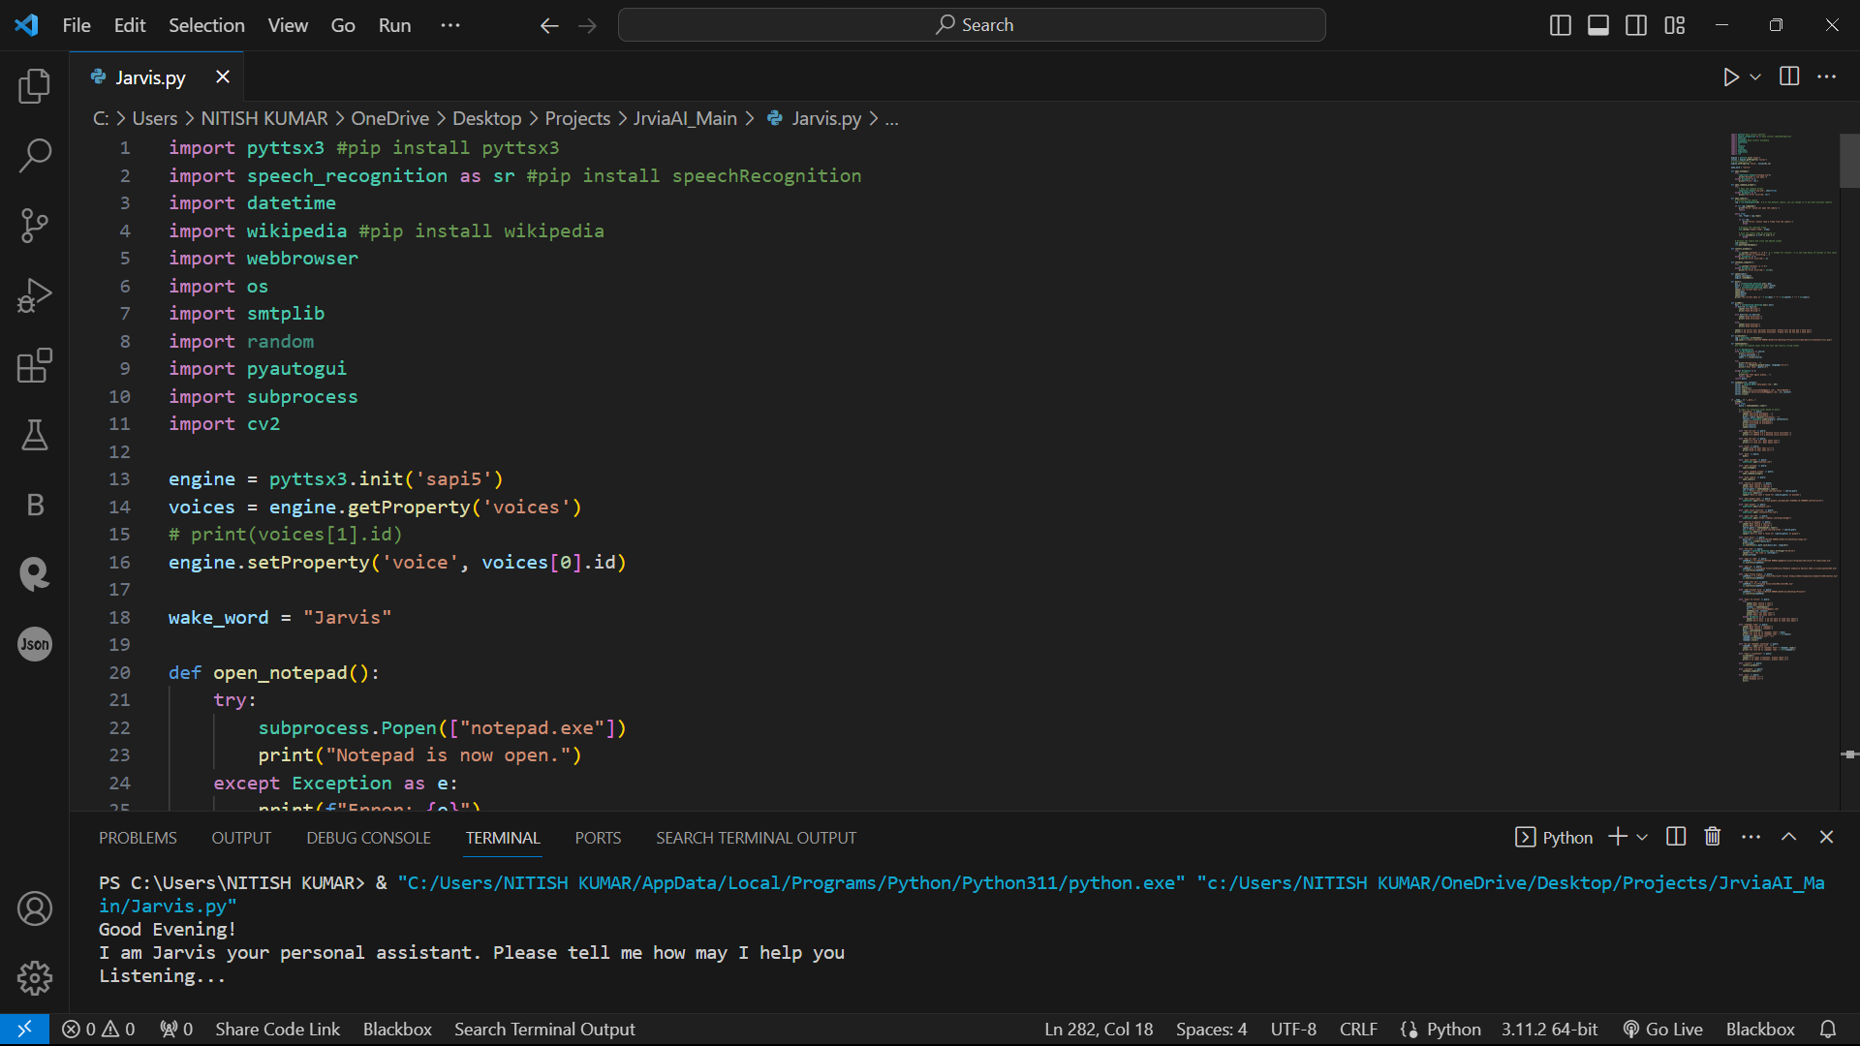
Implementation
Firstly our assistance greet us according to time stamp and then it will asks you to give command to perform

Slide 10
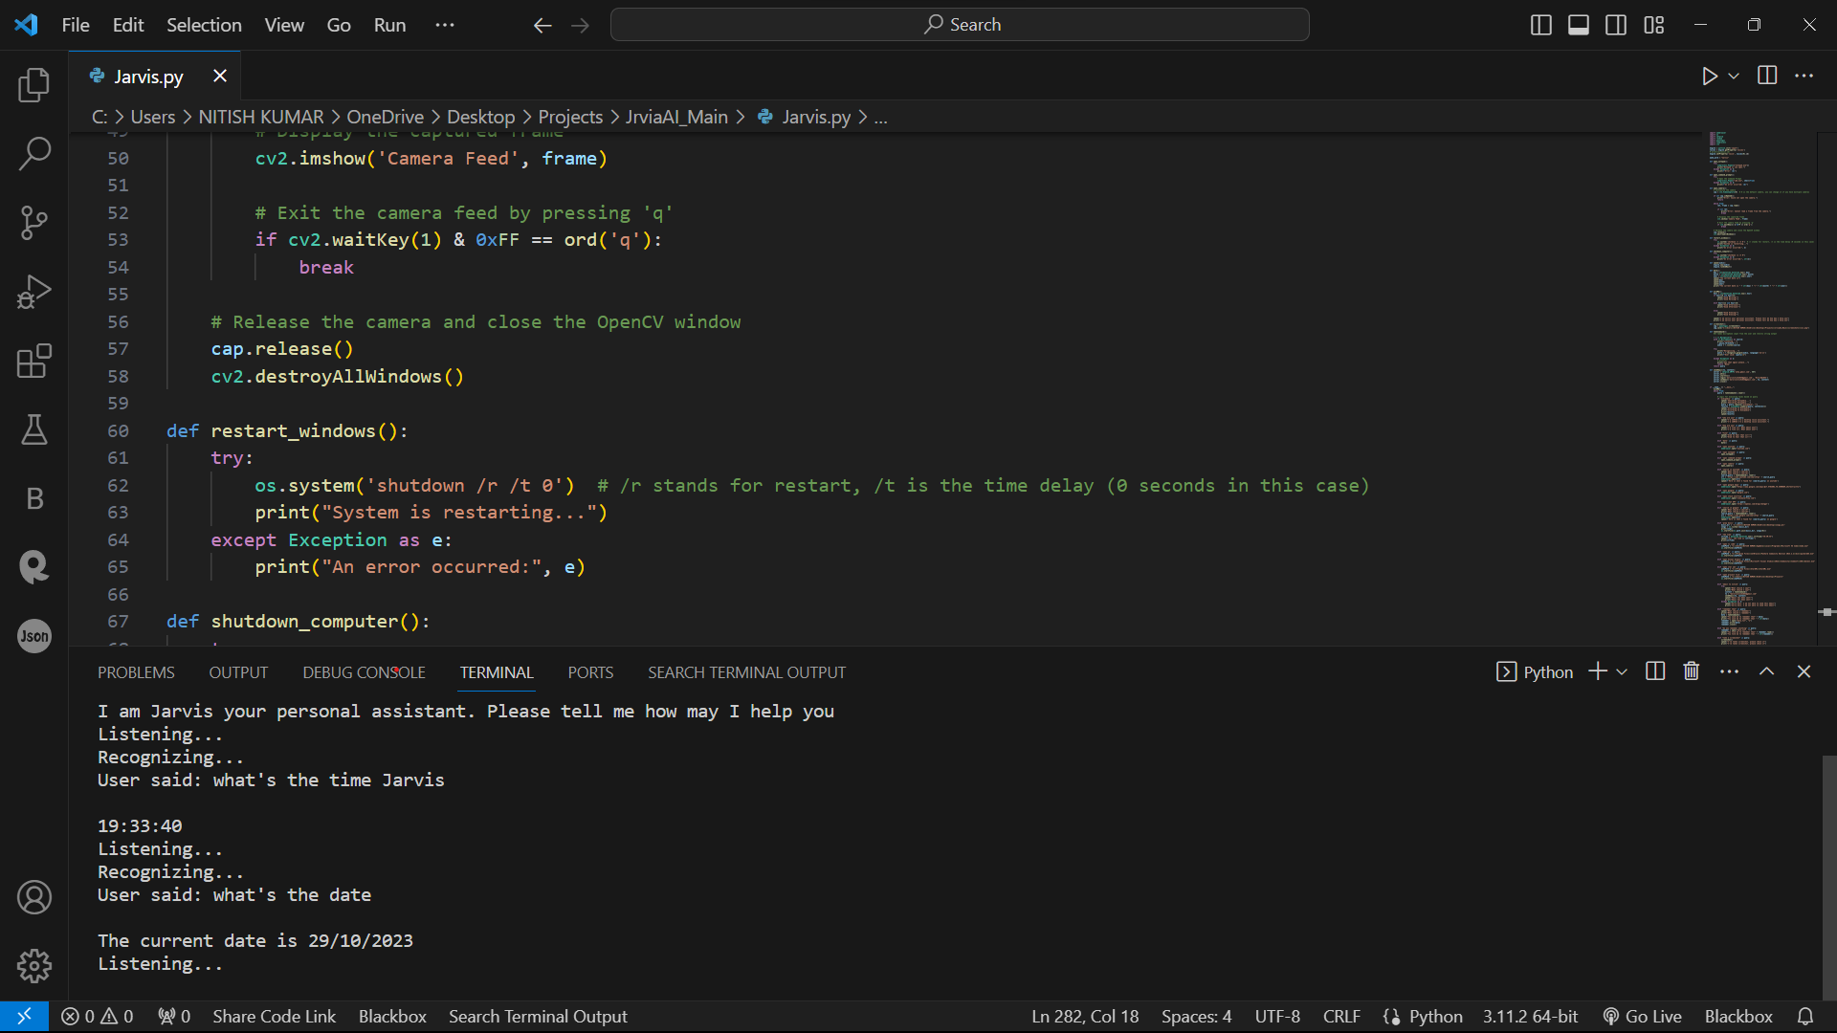
Task 1 :
Calling Time() and Date() Functions

Slide 11
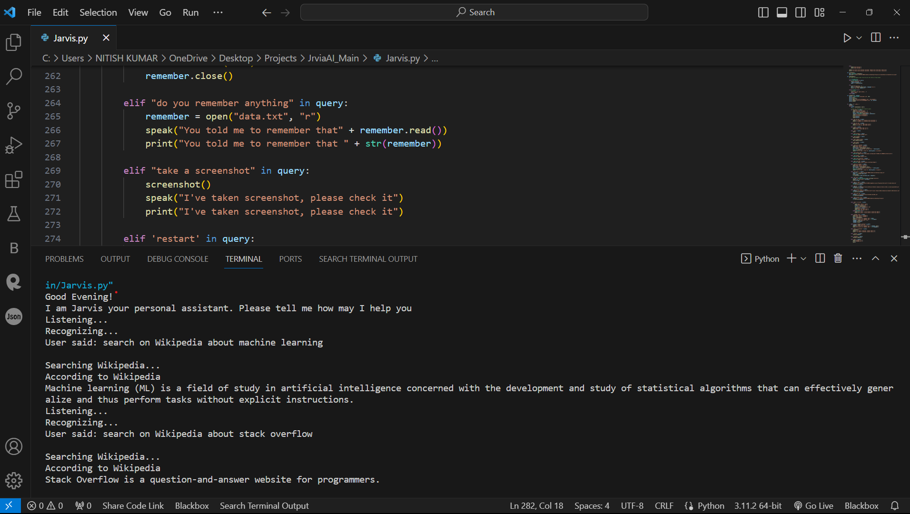
Task 2 :
To search something on Wikipedia
After speaking “Wikipedia” the particular elif statement become true and run the command said by user.

Slide 12
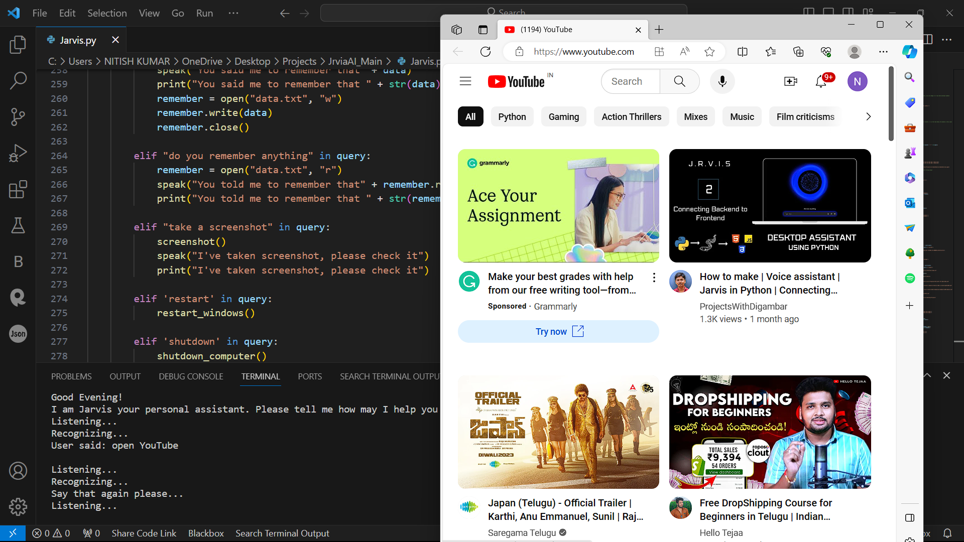
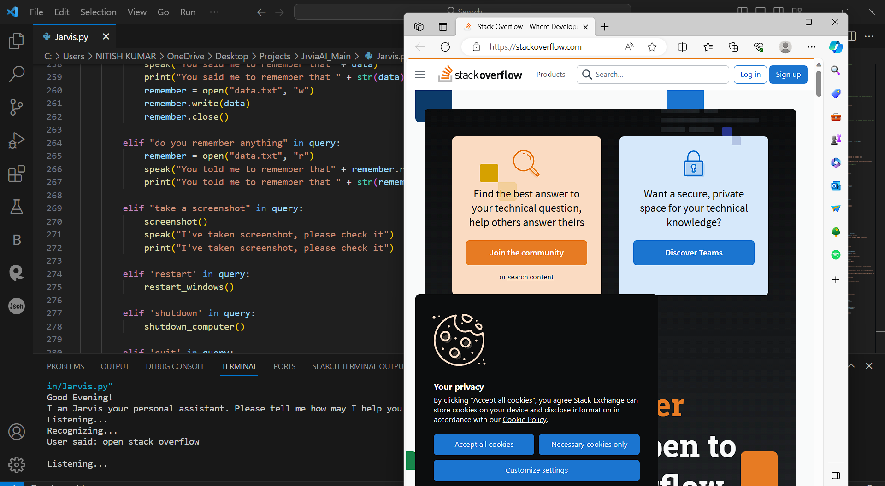
Task 3 :
To open YouTube and Stack Overflow in browser
After speaking “open YouTube” & “open Stack Overflow” the following sites open in browser

Slide 13
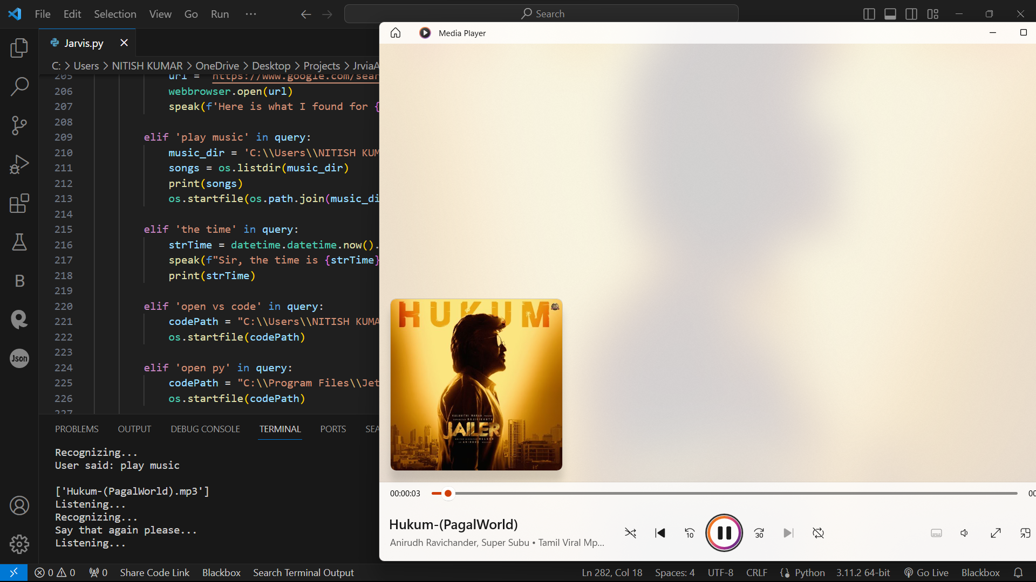
Task 4 :
To Play Music
After speaking “Play Music” the assistant will automatically play a random song which is in user music directory.

Slide 14
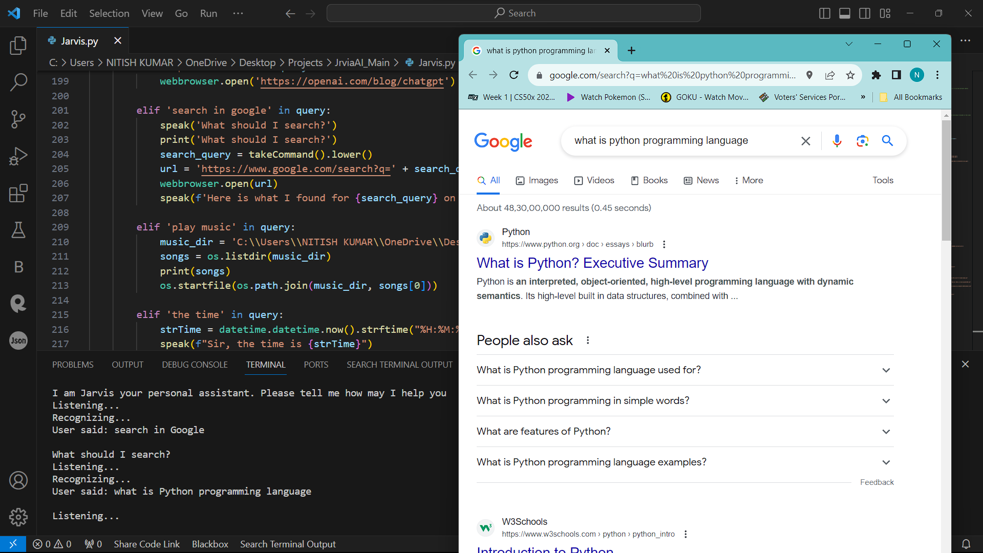
Task 5 :
To search on google
After speaking “search in google” the assistant will search command given by user or if it can’t get that then it will say and print “Can’t open now, please try again later”.

Slide 15
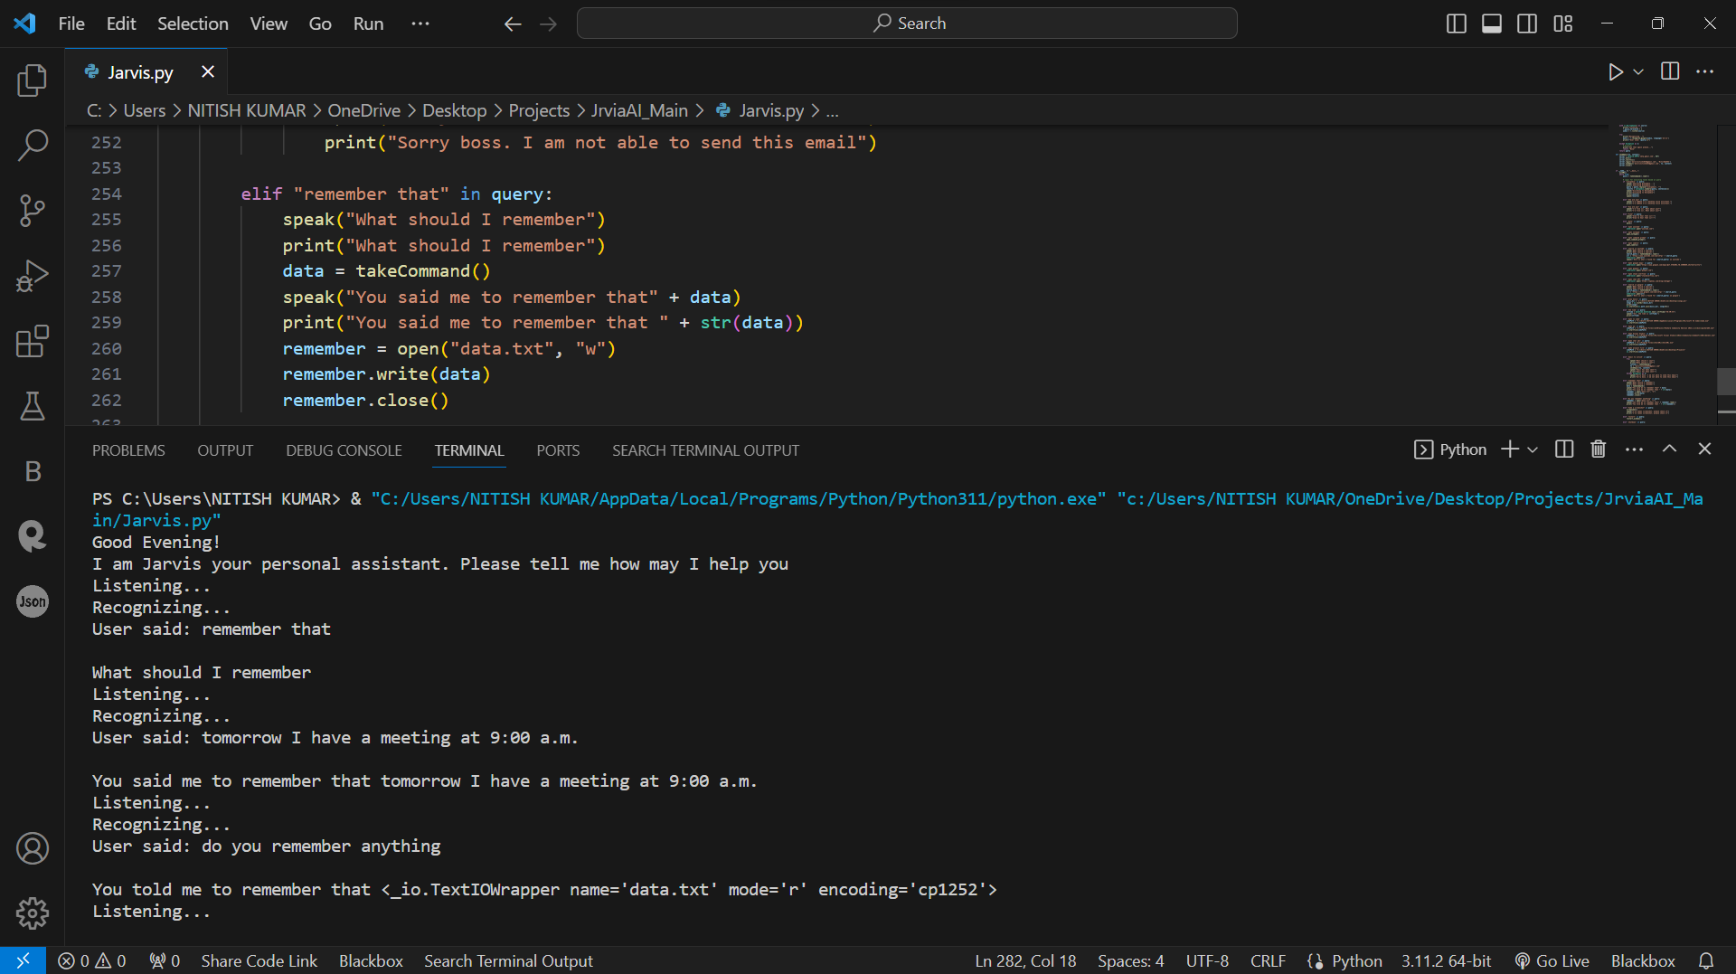
Task 6 :
To remember something
After speaking “remember that” the assistant will ask you that “what should I remember then user tell him particular thing now, if user want to know what assistant remember is then the user has to speak “do you remember anything” then our assistant will tell the user what he told to assistant early.

Slide 16
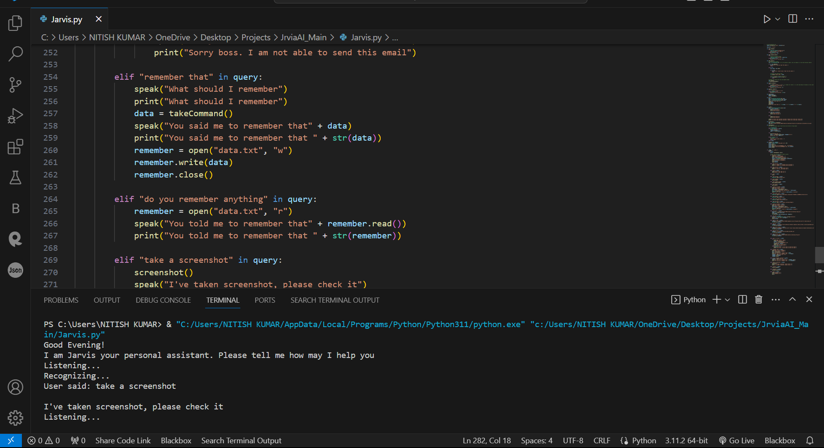
Task 7 :
To take screenshot
After speaking “take a screenshot” the assistant will take screenshot and let you know it has taken screenshot.

Slide 17
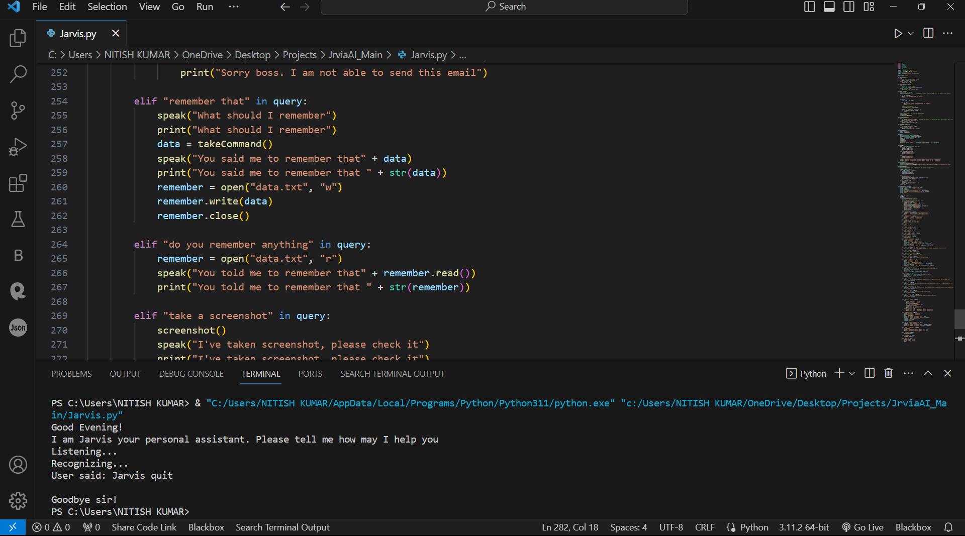
Task 8 :
To make assistant quit the session
After speaking “Jarvis quit” the assistant will offline and then the program will stop.

Slide 18
Advantages:
Disadvantages:
Easy to use
Can work with variety of commands
Custom commands
Secure
Artificial intelligence make advancement in it.
Limited language support
Costly
Expensive equipments
It cannot work in noisy environment
Can’t use for many numbers of people

Slide 19
REFERENCES
Python : https://www.python.org/
Pyttsx3 : https://cutt.ly/ObvJsYr
Pyaudio : https://cutt.ly/gbvJuT9
YouTube :https://www.youtube.com/@CodeWithHarry

Slide 20
THANK YOU !!

